Slide 1

Agro Agency
Presented by
Aravapalli Akash Sumanth Kumar (19KN1A0506)
Under the esteemed guidance of
Mr.P.Raghuveer Associate Professor, CSE Department
DEPARTMENT OF COMPUTER SCIENCE AND ENGINEERING
NRI INSTITUTE OF TECHNOLOGY
(Accredited by NBA:CSE,ECE & EEE)
An Autonomous Institution, Permanently Affiliated to JNTUK, Kakinada
(Accredited by NAAC with “A” Grade and ISO 9001:2015 Certified Institution)

Slide 2
abstract
India is an agricultural based country. The main livelihood of the majority population here is through farming who well in villages and feed the whole country. Food is one of the basic necessities of a human being, which is fulfilled by the framers. However, they fail to get proper price of the stock they sell in the market. Hence, they are deprived from getting profits for their stock. AGRO AGENCY helps them in getting proper price for their stock and even get profit for their efforts.
The main scenario of AGRO AGENCY is the project will declare the minimum and maximum value of the crop a daily update. When farmers register in the agency the agency will help in monitoring the crops throughout the season.So that the farmers will not get any loss.The agro agency will also helps the crop progress.

Slide 3
Contents
Introduction
Benefits for Farmers and customers
Use Case diagram
SRS
Output Screens
Conclusion

Slide 4
Introduction
Organic production is an overall system of farm management and food production that aims sustainable agriculture, high-quality products
The main idea of the project is to create a web application to provide the fresh quality from the farms to customers

Slide 5
Benefits for Farmers and customers
Easy to sell
Easy to buy
Customers can interact with the users

Slide 6
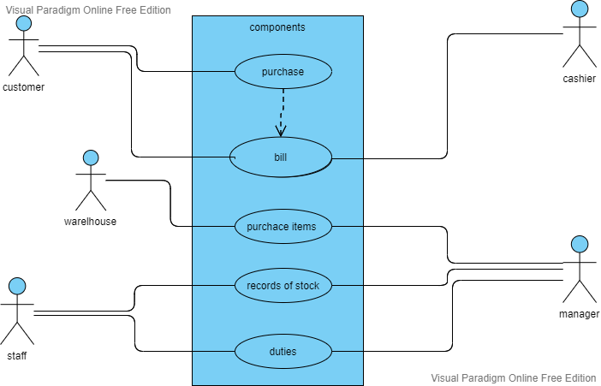
Use case diagram

Slide 7
SRS
On Client side
HTML,CSS,PHP
On Server Side
XAMPP

Slide 8
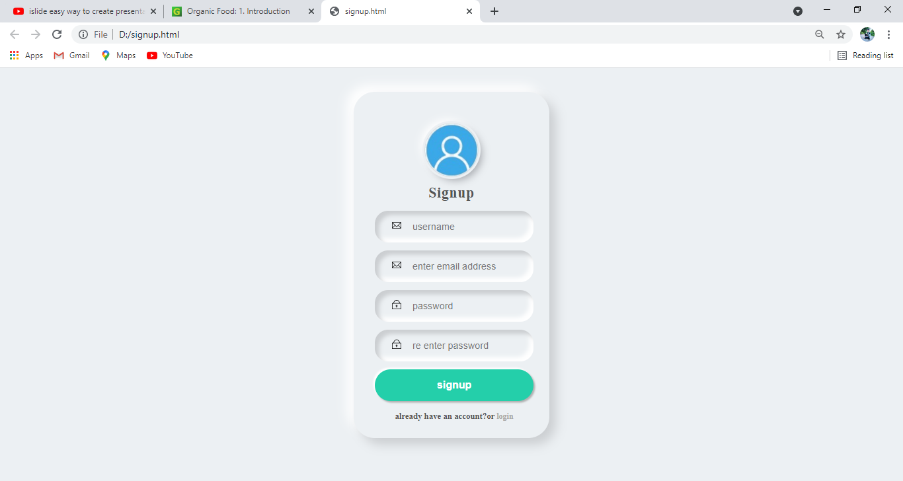
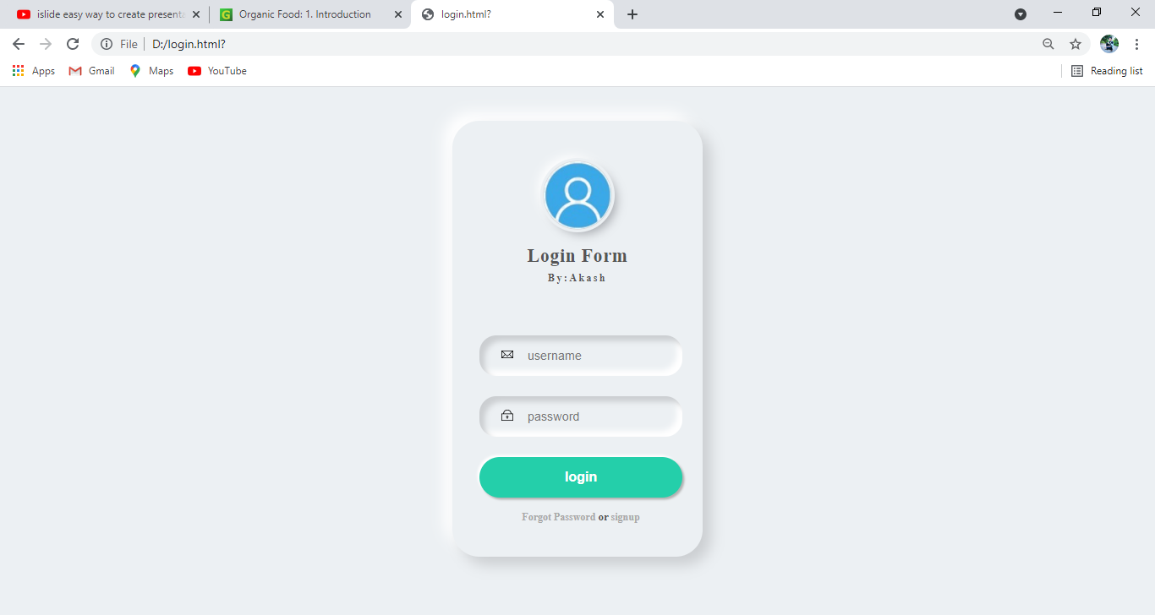
Output Screens
Signup page
Login Page

Slide 9
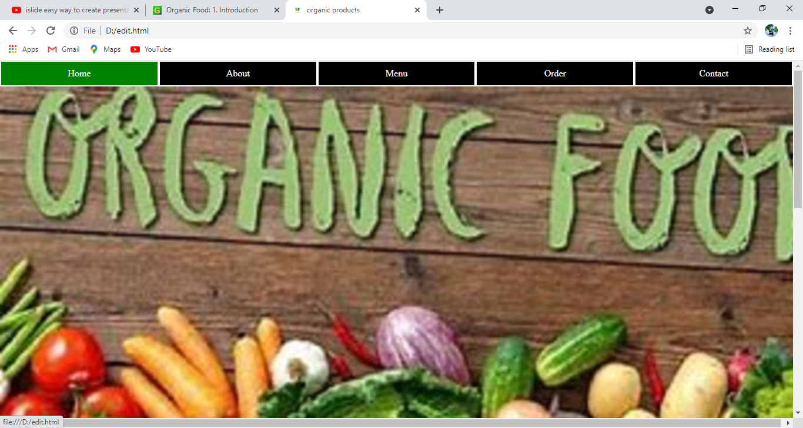
Output Screens
Home Page

Slide 10
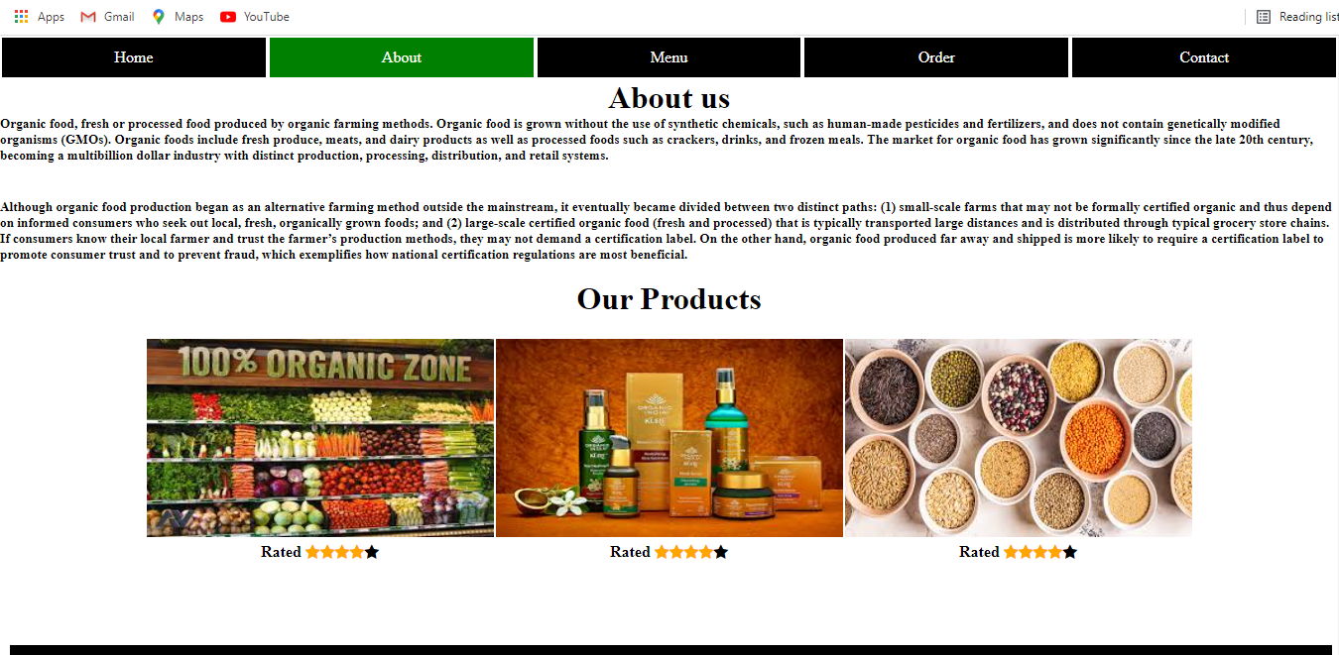
Output Screens
About page

Slide 11
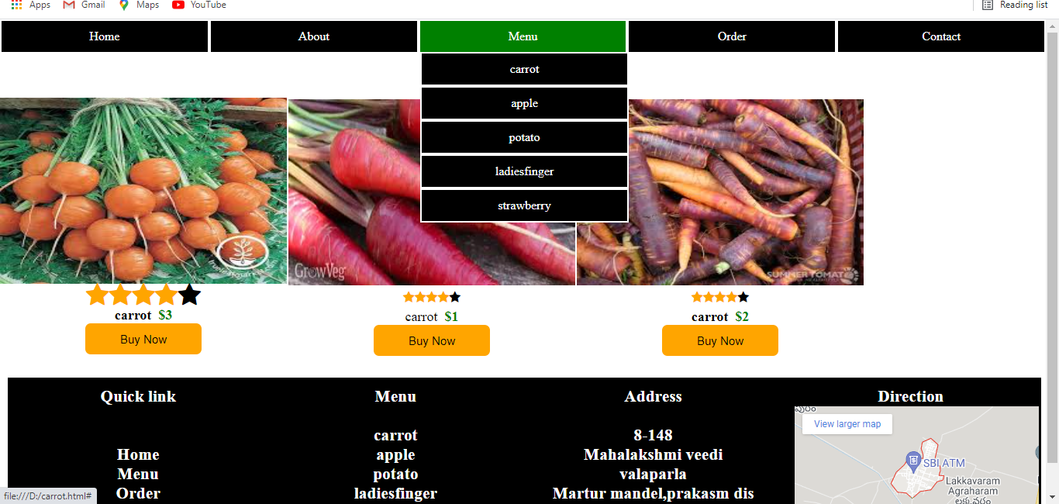
Output Screens
Menu Page

Slide 12
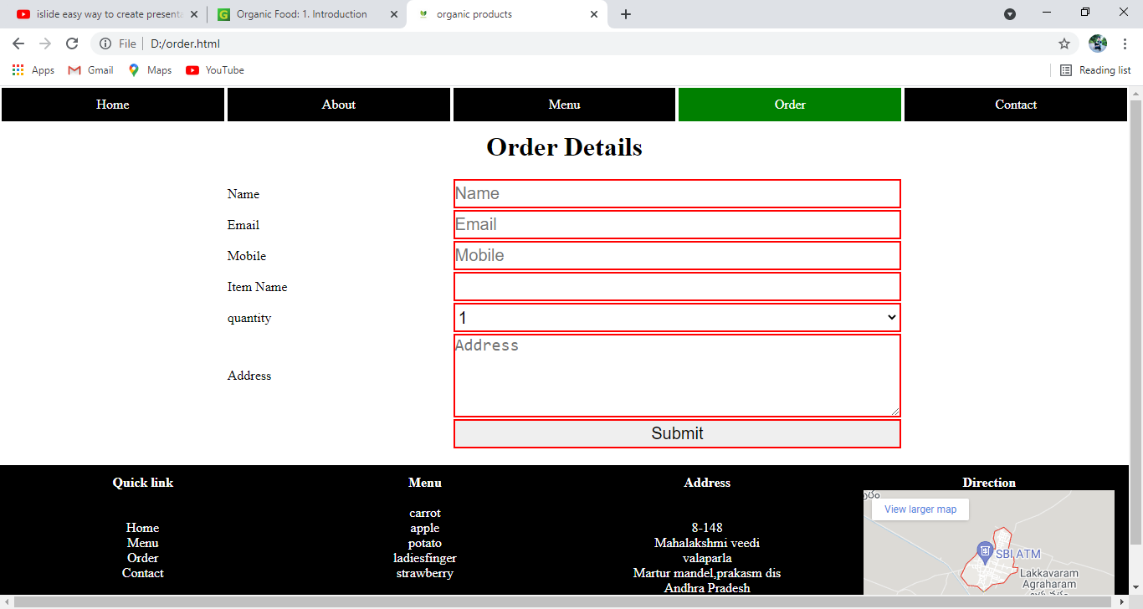
Output Screens
Order Page

Slide 13
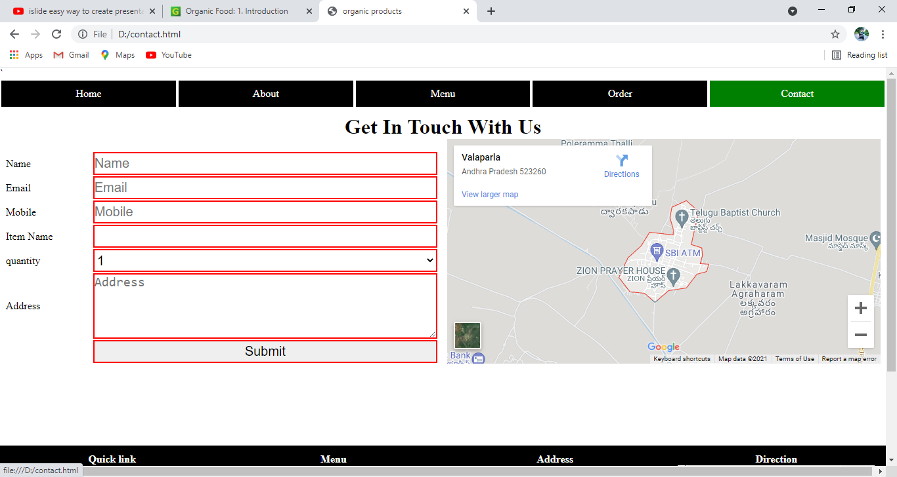
Output Screens
Contact Page

Slide 14
Conclusion
By developing this application we can contain some preservative that makes the food fresh for longer time and it is also free from all the chemicals. The organic agriculture is also good for the environment.

